Slide 1
Welcome, Southside Community!
Annual Meeting,
October 24, 2023

Slide 2
Honoring Our History, Dreaming Our Future
Southside Family School began 50 years ago as a dream born out of the civil rights movement. It first began as a project backed by the University of Minnesota through the federal Model Cities grant funding - a program seeking to fund ideas of community members that were committed to antiracism and the elimination of poverty. The founders - teachers and families - dreamed of an integrated school committed to truth telling - having young people understand the origins and devastating impacts of racism, while also learning from the freedom dreams and resistance of movement leaders so that they could become shapers of a different future. Southside evolved over the years, becoming a multigenerational community in Minneapolis committed to connecting our history to our present and dreaming our future. As we enter the 50th year of our school, it feels as if we are once again at a fresh beginning relearning what justice looks like now and for future generations. Not a relearning that forgets our rich history, but relies on the history as the foundation for a stronger future.
Notes:
Not this whole text, but do you think we should do a brief history

Slide 3
Honoring Our History
Social Justice
Community Partnerships
Family School
Travel Study - Archival Research

Slide 4
Dreaming Our Future
We need you!
Multiple invitations tonight: Thinking about your gifts, passions, and hopes for our school, where can you contribute to our growth and thrivance?

Slide 5
Tonight’s Time Includes:
Social Justice: Current Curriculum and This Year’s Goals
Using Data to Support Student Growth: Title and Intervention Programming
Healing Justice: Grant and Programming
Student Voice and Leadership
Finances
Family Opportunities/Invitations
Travel Study
Fundraising
Authorizer
Announcements
Board Elections

Slide 6
Social Justice: Current Curriculum and This Year’s Goals
Grade Level Core Content (literacy/ELA, math, science, social studies), Art and Spanish Enrichment, Gym, Park/Outdoor Time, Clubs (Student Driven Electives)
Outside space (behind the Arc), Accessing community opportunities with vans (sign waivers here!), Library partnership, Science Museum Lending Library
K-8 Scope and Sequence by end of school year (State and Social Justice Standards)
Community Partnerships: Guest Speakers/Teachers, Organizations
Are you connected with someone in our community that would be an incredible guest speaker/teacher (elders, organizers/activists, artists, leaders, change makers, future builders) for our students?

Slide 7
Table Discussion
What are your hopes and dreams for a social justice education?

Slide 8
Southside Title Program
Heather Busch
Title Coordinator & Interventionist

Slide 9

Southside has a Title 1 Program!
Title I is a federally funded program whose purpose is to ensure all children have a fair, equal, and significant opportunity to obtain a quality education.
Title 1 allows students who are experiencing academic difficulties (specifically in reading & math) to receive extra help and individual attention during the school day.

Slide 10

We are a Targeted Assistance Program
This year, we have a Targeted Assistance Program. This means that eligible students are receiving support through a small group or individual instruction provided directly by an interventionist (Heather).

Slide 11

Which students are eligible for this support?
We decided which students would receive these academic supports this fall by analyzing beginning of year literacy and math data from FASTBridge assessments, as well as talking with teachers and families about their own observations in the classroom and at home. Those families have been contacted about their child’s eligibility and participation in the program.
If you would like to discuss if your child is eligible for Title 1 support, PLEASE reach out to Heather. All families whose child is performing below grade level benchmarks is potentially eligible to receive Title services.

Slide 12

How can I be involved?
Join CISA, (our Curriculum, Instruction & Student Achievement board committee) In order to determine the needs of our school for the coming year. We will be doing a comprehensive needs assessment in order to prioritize focus areas for the 24-25 school year! The voices of family members are essential for this work. Contact Heather or Alissa for more info!
Notes:
This year, Southside is considering applying to become a Schoolwide Title program, which would allow us to use interventions that impact all students.
In order to do this, we are putting together a Title Leadership Team that will be comprised of board members, leaders, teachers, and family members. This team will do a comprehensive needs assessment in order to prioritize the needs of the school and make a plan for the 24-25 school year. We need families to be a part of this process in order to ensure that the needs of our students and community are centered in this process!

Slide 13

How can I be involved?
If you are interested in volunteering to provide additional academic support to students or being a guest reader/speaker for students, this is also an area of development for the school. Please reach out to Heather or your child’s teacher!

Slide 14
Healing Justice: Grant and Programming
Stronger Connections Grant: 3 years of funding
Healing at the center of a social justice education (visual with dignity, safety, sense of belonging)
Pushing in to classrooms and building a common language around a few tools
Community Care Challenge
  Practicing the community care challenge at home
Community/family education and engagement
Scope and Sequence for: A) Ways of Being (Antiracist Social Emotional Learning and Restorative Justice) and B) Content and Academic Skills

Slide 15
dignity
sense of belonging
safety

Slide 16
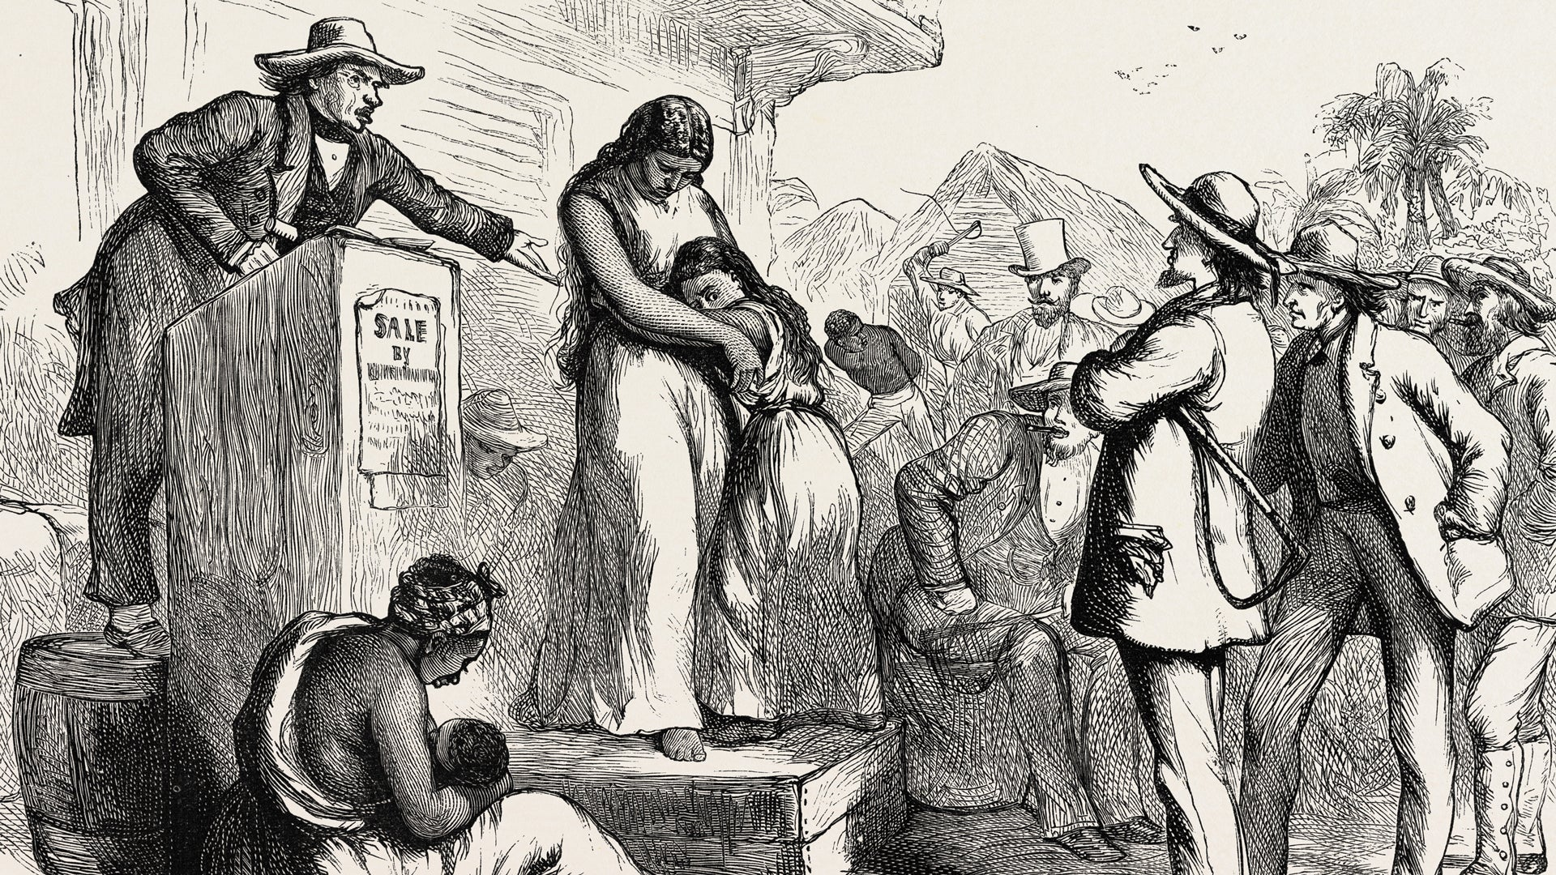
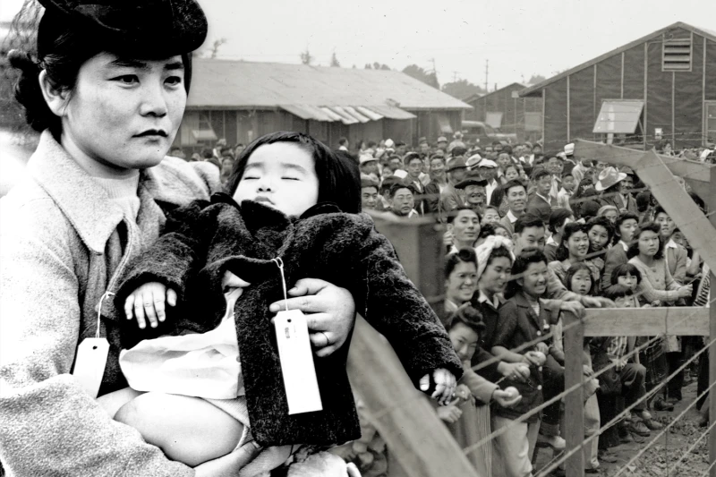
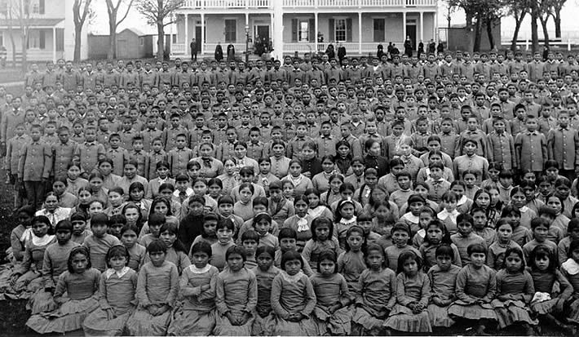
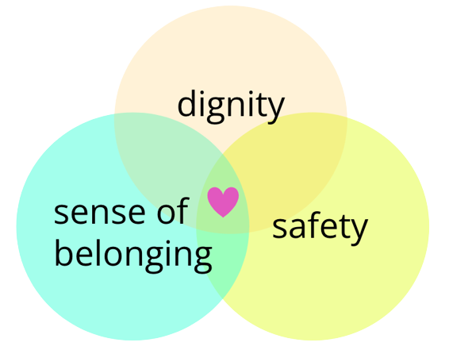
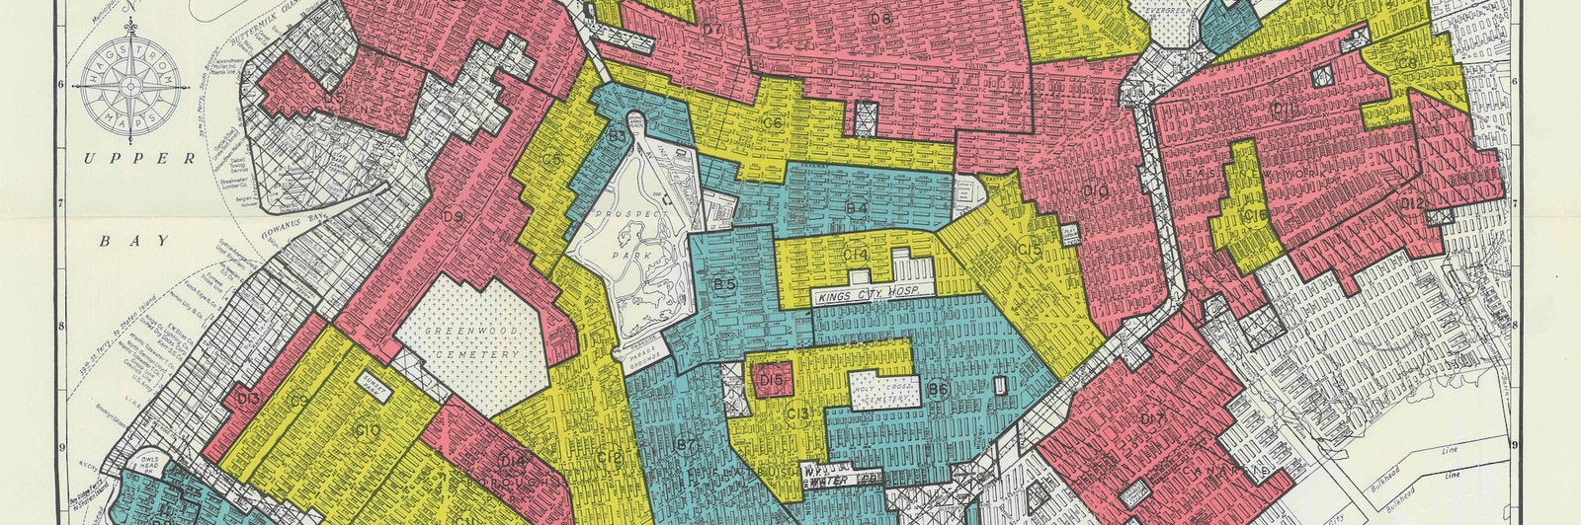
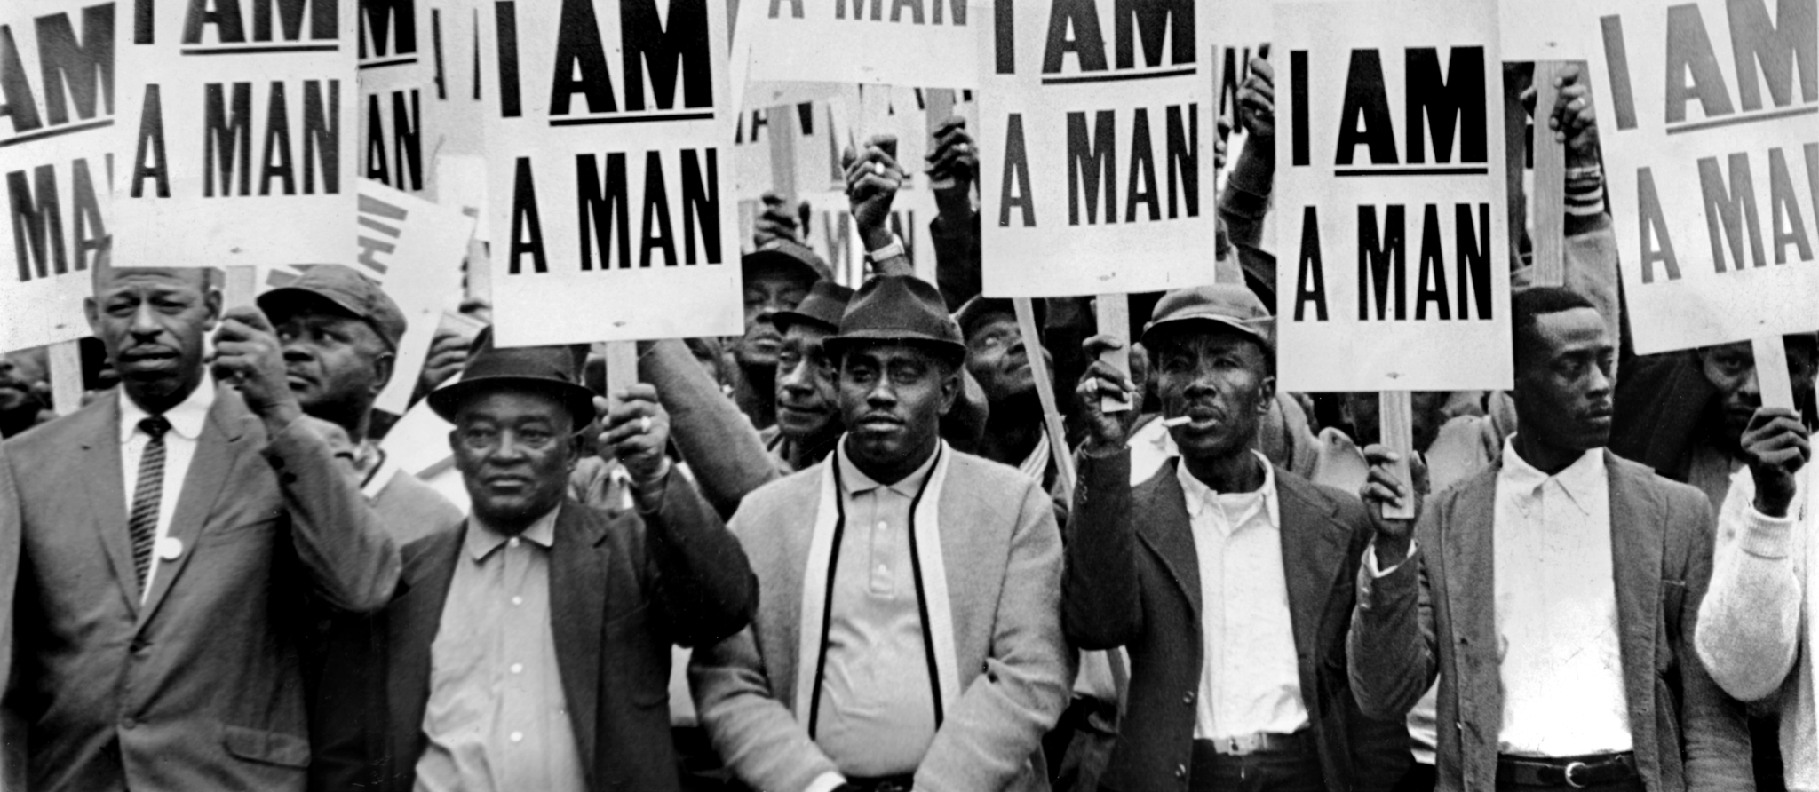
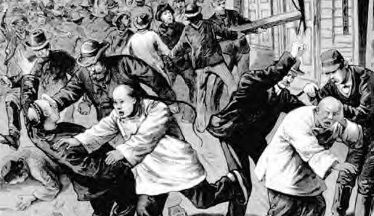
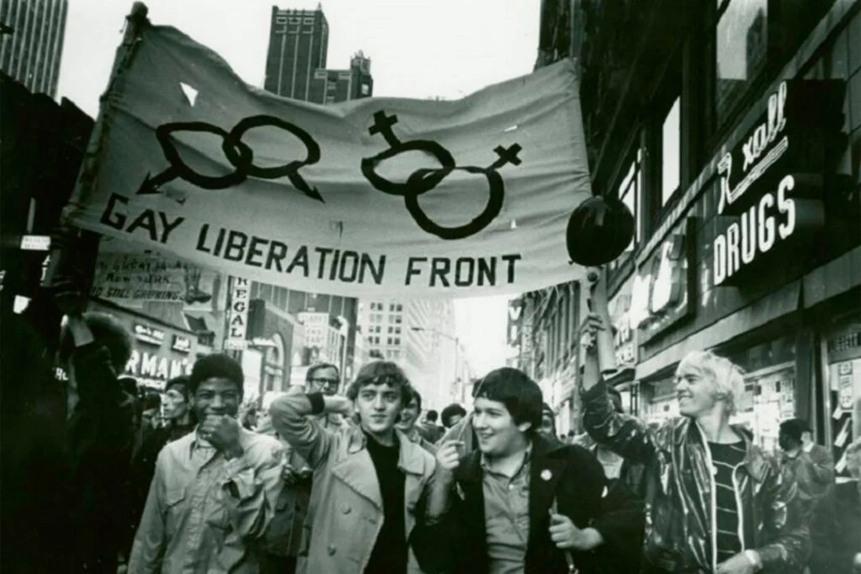
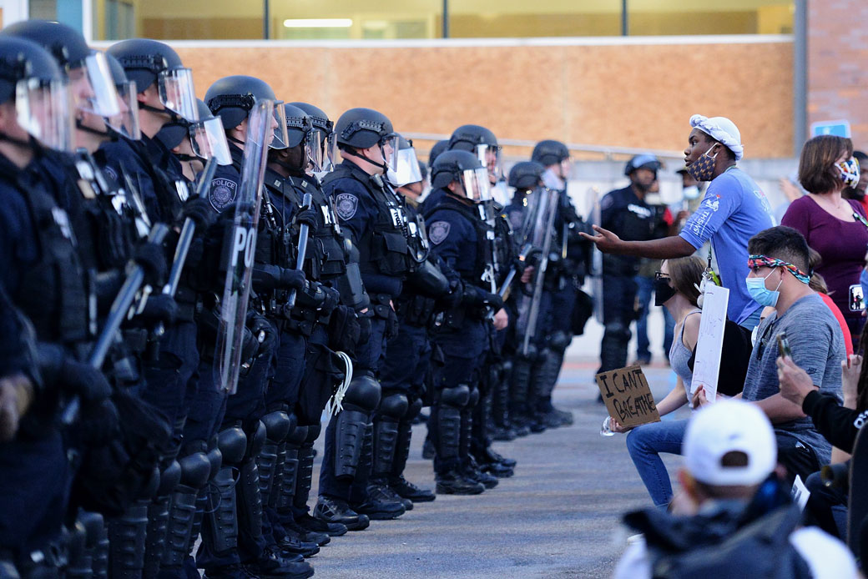
Notes:
Abolition begins with community care. Dee’s class start here 10/23.

Slide 17

Notes:
These concepts are organized in sequence, but it’s important to know that they may not happen sequentially, especially at first. Sometimes we might need to wait until we have used some regulation strategies before we can articulate our needs. And if we are not able to articulate them in the moment, it’s always okay to go back to it later. We also might miss our body signals because we were too caught up in the moment, but it’s helpful to be aware of what body signals you had in the moment, so you can become familiar with them and use them in the future.

Slide 18
Student Voice and Leadership
Student Voice driving clubs
Student Council just beginning to form
Intentional seeking of student feedback
Listening to student dreams for their educational experience

Slide 19
Finances
Where we are
What we are doing:
  Sale of lot
  Grant writing
  Strategic fundraising
  Strategic recruitment

Slide 20
Family Opportunities/Invitations
Sign up to be part of parent engagement group
Organizing listening sessions to get family perspectives
Identify community needs and offer parent education opportunities
Potential Advisory Group?
Committee Work
Board Committees
Wellness Committee
Volunteering
Share your strengths with clubs!
Organizing Community Partnerships
Go on field trips
Guest speakers for assemblies - you or someone you know?
Donate
Field Trip Funds
General Funds (snacks, materials for clubs/classes)
Fundraising
Give to the Max
Monthly contributions

Slide 21
Table Discussion
What kind of opportunities (education, social, community engagement, political activism, etc.) do you want to see for families at Southside?

Slide 22
Travel Study
Reviving our history
Place based experiences as part of a social justice education: Local, Regional and National
Fundraising to support sustaining this opportunity
Working toward Detroit, Spring 2024

Slide 23
Fundraising
Join the Fundraising Committee!
It will be fun and a great way to support the school and engage with other parents to build community. Fundraising experience is great but not required! We have an ambitious but critical goal to raise funds for the school this year and we need parent support.
Give to the Max Day:
Create your own fundraiser page (we will supply a template) and share with family/friends/community to raise money for SFCS
Share SFCS' campaign on social media/email
If you own a business, would you consider donating a % of sales that day OR asking customers to round up to donate to Southside?
Monthly Contributions:
Sign up on Southside GTTM Day’s page to make a sustaining contribution!

Slide 24
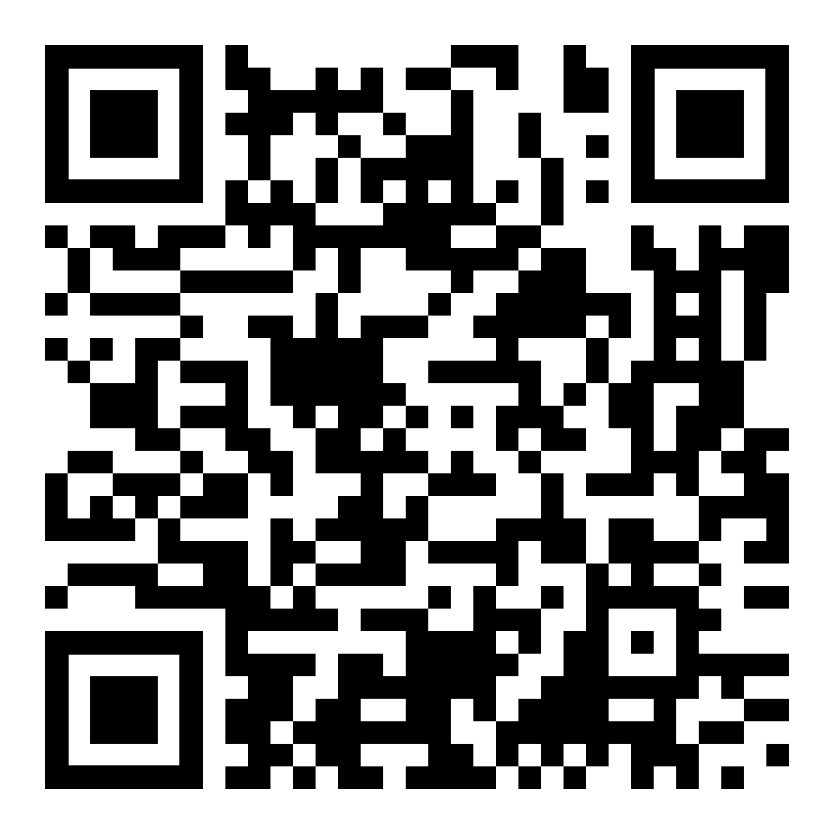
Fundraising
Monthly Contributions:
Sign up on Southside GTTM Day’s page to make a sustaining contribution!
Click on the QR Code to go directly to our Fundraising page
Share the QR code with family, friends, and community!

Slide 25
Authorizer Transfer
VOA to Pillsbury United Communities
Alignment with justice-oriented mission
Antiracist authorizing processes
Opportunities for our students and community partnerships

Slide 26
Announcements?

Slide 27
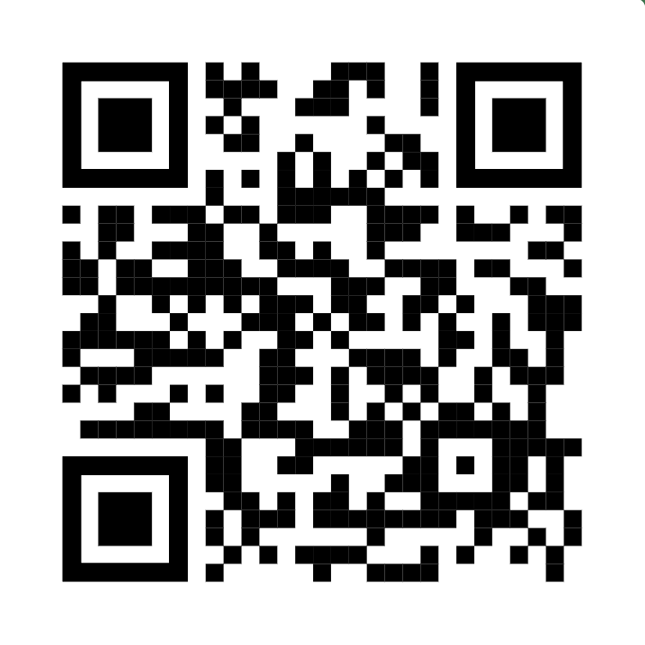
Board Elections
Use your cell phone to scan the QR code on the right
Caregivers/Parents of enrolled students and Staff are eligible to vote for all seats
Follow the instructions on the google form to submit your votes for School Board

